Slide 1
ANJALAI AMMAL MAHALINGAM ENGINEERING COLLEGE
DEPARTMENT OF ELECTRONICS AND COMMUNICATION ENGINEERING
EMERGENCY COMMUNICATION SYSTEM FOR HILLS & FOREST REGIONS
USING IIOT
PROJECT SUPERVISOR
BATCH MEMBERS
Dr.R.RAJAGANAPATHI M.E., Ph.D.,
ASSISTANT PROFESSOR
DEPARTMENT OF ECE
VIGNESHWAR P 820420106051
INBARAJ A 820420106303
LAKSHMAN S S 820420106305
PUVANESAN A 820420106307

Slide 2
OBJECTIVE
Our idea is to design and implement an emergency communication system for hills and forest regions, where conventional communication technologies, such as cellular networks or satellite phones, are not available or feasible.
So the communication of emergency system via the Ad hoc Wireless sensor networks can be easy accessible, and an affordable model for the people.
We’re are going to make this possible for the people through the user friendly using IIOT.

Slide 3
EXISTING METHOD
HAM RADIO
It’s one of the technology which is used for the emergency communication.
It uses radio frequencies to send voices, digital data, and Morse code across the globe. Ham radio operates based on the concept of electromagnetic waves.
PROS
Ham radio operators can communicate during emergencies when other systems (cellular, internet) are down due to failures or disasters.
Emergency Situations: It provides long hours of communication during emergency situations and is easy to set up and Ham radios use a large range of frequencies, so they don’t get overcrowded.
CONS
Licensing: To operate legally, hams need an amateur radio license. Different license classes grant varying privileges, from local communication to global reach.
Cost: Not much cost effective.

Slide 4
LITERATURE REVIEW:
TITLE | AUTHOR NAME | YEAR | JOURNAL NAME | DESCRIPTION
QoS Routing and Traffic Scheduling In Long-Distance 802.11 Wireless Mesh Networks | Zhao Zenghua, He Ming, Zhang Jie | 2012 | IEEE XPLOER | wireless mesh networks are expected to provide multimedia traffic service in addition to basic Internet access, as more such networks have been emerged in real life which is done by QoS routing and scheduling algorithms to guarantee the QoS of real-time traffic.
Implementation of LoRa Mesh Library | Joan Miquel Sole, Roger Pueyo Centelles, Felix Freitag Mesegeur | 2022 | IEEE XPLOER | Proactive Routing Protocol : Ensuring reliable data packet delivery among IoT nodes without the need for a central LoRa-WAN gateway. Mesh Network Flexibility: This approach allows end nodes to communicate directly with each other, fostering a more flexible and decentralized IoT ecosystem.
Secure IT using Firebase, Google Map and Node.Js | Shanta Khatun, Fahim Hossain Saiki, Milon Biswas | 2019 | ZENDY | Firebase Functions, delivers notifications to users even when the app is not in the foreground, enabling communication between admins and users for gps notifications, updates, and admin messages, all at no cost.

Slide 5
PROPOSED METHOD
Basically in rural areas like hilly and forest areas, to utilize a fixed network is complex but to create a mobile network, which is very efficient and effective to use
which is accomplished via Ad hoc mesh network. A device of node which
given to the user for the communication(Additional transmitter device)
If any emergency occurs the user need to communicate the information to rescue in text message by serial communication team via the rescue application, who may be present in very long range, which is not feasible to communicate through this mesh network, so we implement a long range communication technology which is attained through LoRa module which enables the approx distance of 1 km range.
After the LoRa module reaches the cellular network region, the data which is brought from the emergency area which is stored in cloud database. The cloud database which has direct link with rescue team and they have the node table through that they find location of emergency.

Slide 6
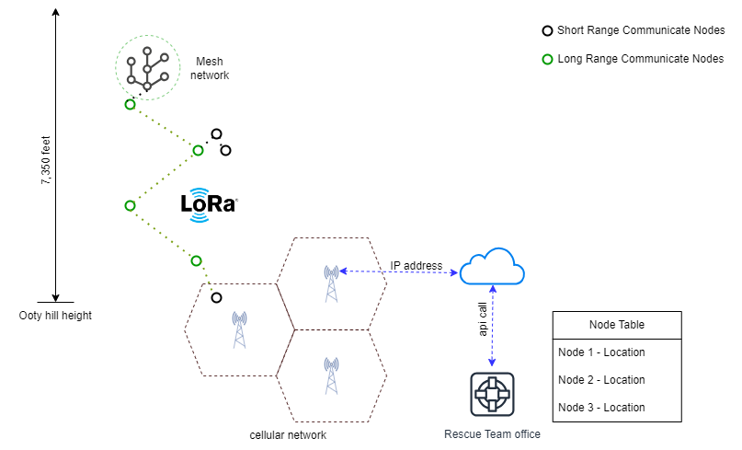
MODEL DIAGRAM

Slide 7
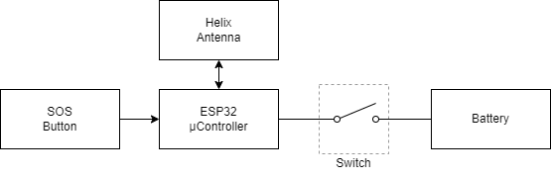
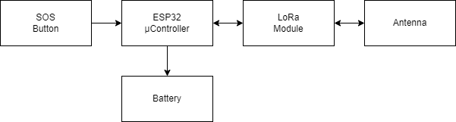
BLOCK DIAGRAM
Short Range Node:
Long Range Node:

Slide 8
REQUIREMENTS:
HARDWARE:
ESP32 Microcontroller
LoRa Module (915MHz)
Helix Antenna
Pull-up Button
Switch
Battery 5v-2Amp
SOFTWARE:
Arduino IDE
Firebase Cloud Database
Flutter

Slide 9
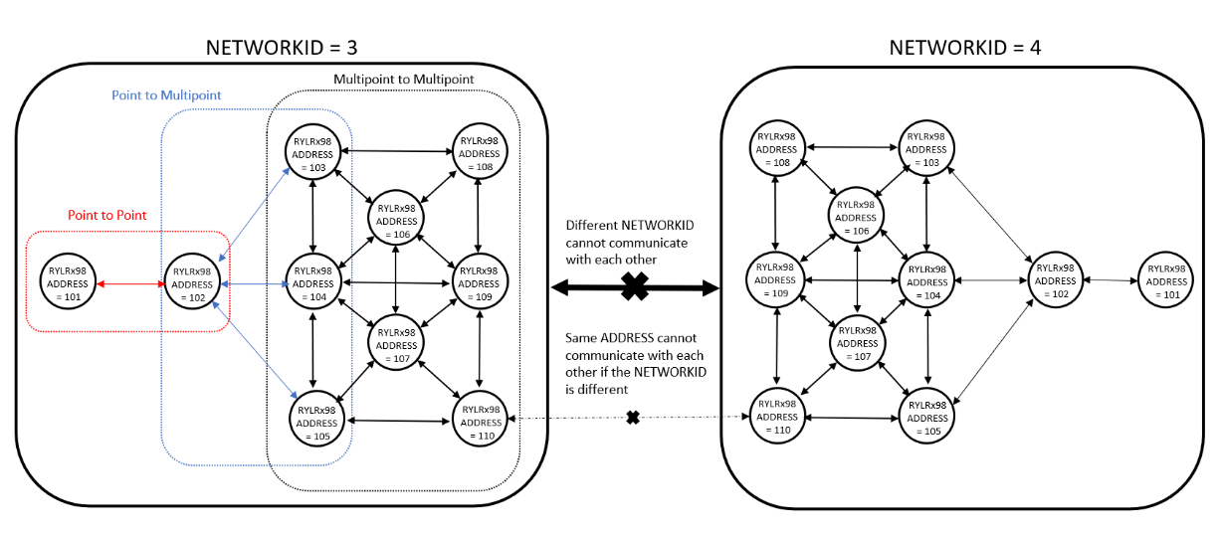

Slide 10
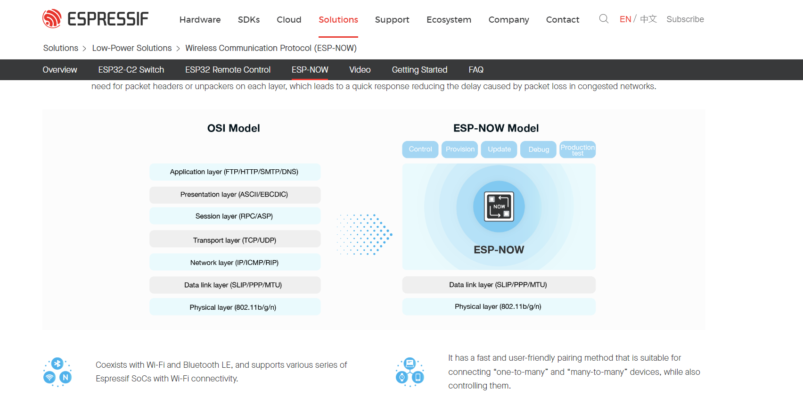

Slide 11
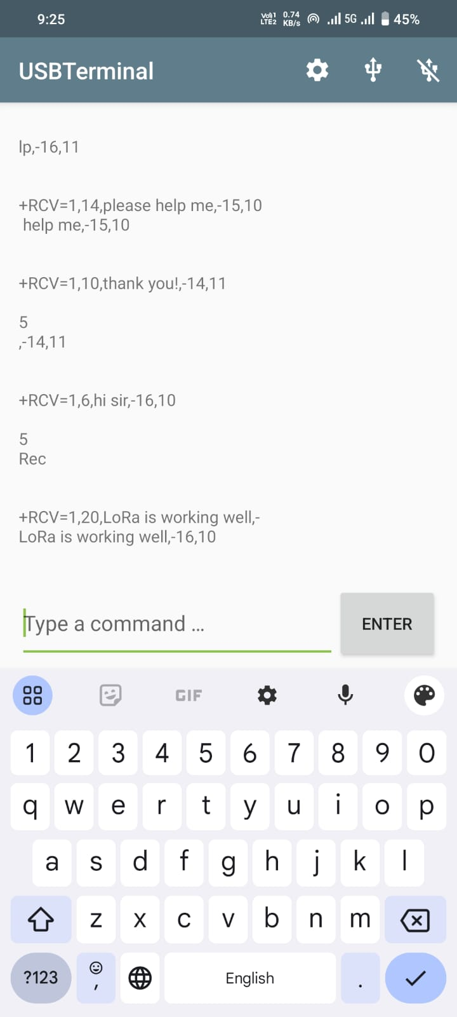
Transceiver:

Slide 12
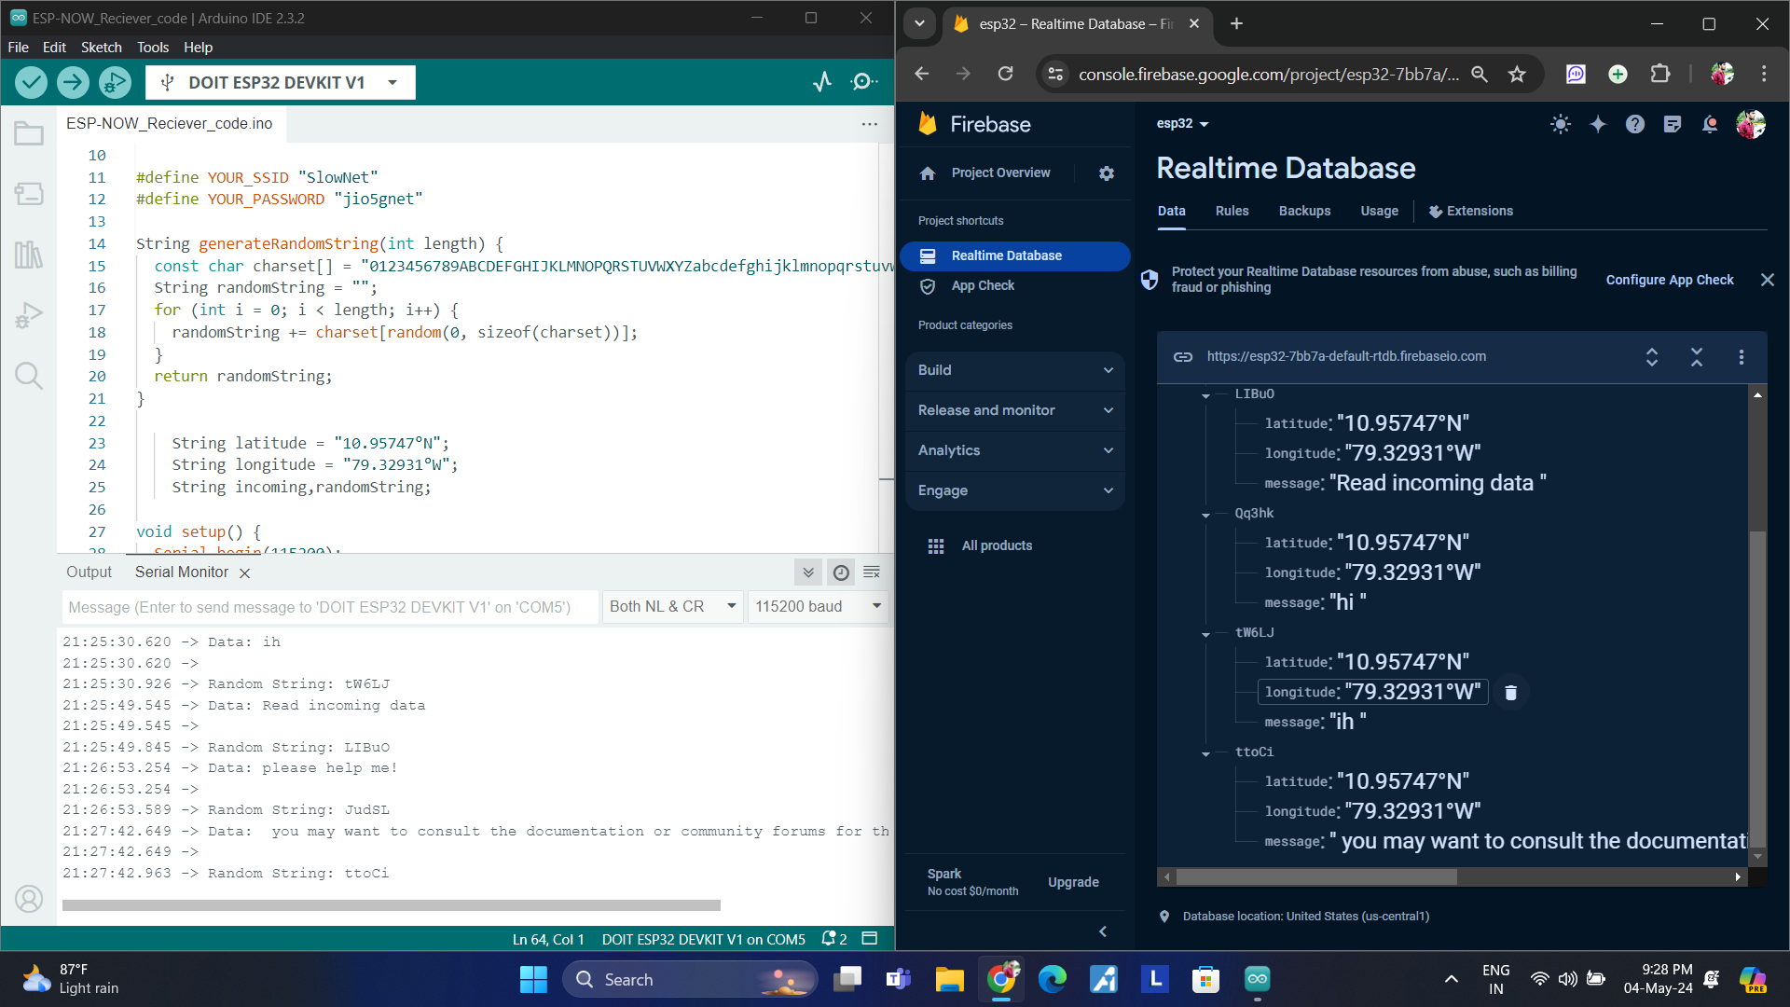

Slide 13
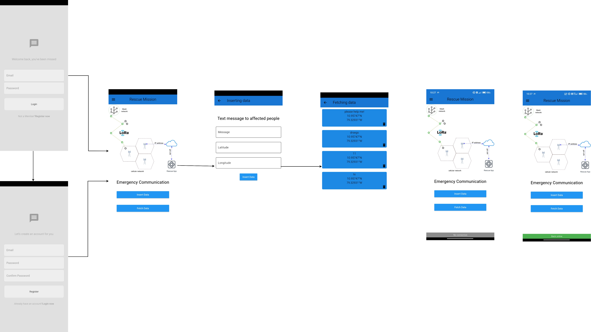
App Interface:

Slide 14
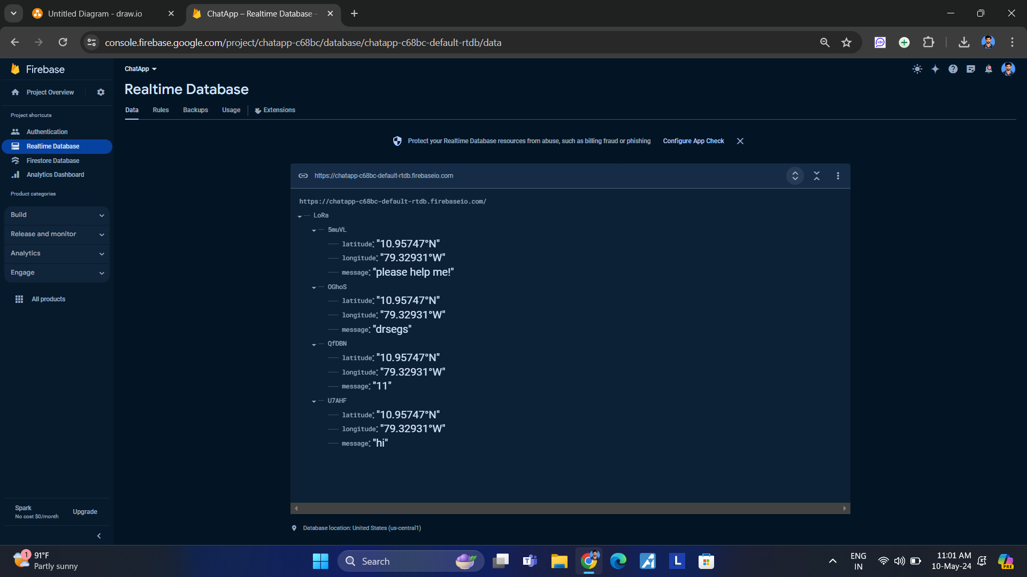

Slide 15
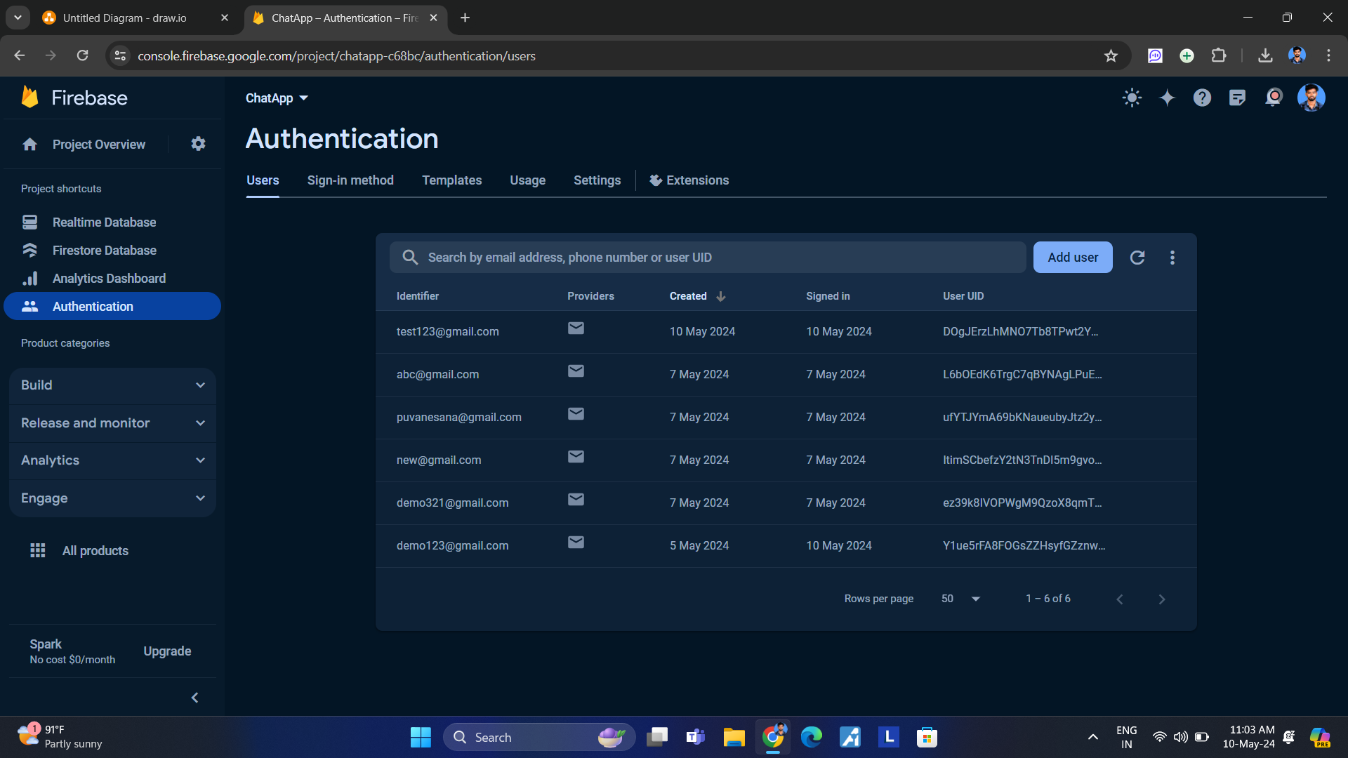

Slide 16
Thank you!

